Slide 1

Directing Customers to Subscription Through App Behaviour Analysis
Meet Shah

Slide 2
Introduction
1

Slide 3

Business Case Study
In today's market, many companies have a mobile presence. Often these companies provide free products/services in their mobile apps in an attempt to transition their customers to a paid membership. Some examples of paid products, which originate from free ones, are YouTube Red, Pandora Premium, Netflix, Disney+Hotstar, AmazonPrime, Audible Subscription and Spotify. Since marketing efforts are never free, these companies need to know exactly who to target with offers and promotions.
1. Market: The target audience is customers who use a company's free product. In this case study, this refers to users who installed (and used) the company's free mobile app.
2. Product: The paid memberships often provide enhanced versions of the free products already given for free, alongside new features. For example, YouTube Red allows you to leave the app while still listening to a video.
3. Goal : The objective of this model is to predict which users will not subscribe to the paid membership, so that greater marketing efforts can go into trying to 'convert' them to paid users.

Slide 4


Business Challenge
In this case study we will be working for a fintech company that wants to provide its customers with a paid mobile app subscription that will allow them to track all their finances in one place. To attract customers, the company releases a free version of their app with some of the main features unlocked.
The company has tasked you to identify which users will most likely NOT enroll in the paid product, so that additional offers can be given to them. Because of the cost of these offers, the company does not want to offer them to everybody, especially customers who were going to enroll anyways.

Slide 5
Data Explanation
2

Slide 6


Notes on Data
The data for this project are manufactured fields based on trends found in real world Case Studies. The fields describe what companies usually track from their users, and the distributions are based on observed distributions in real world analysis. This means that, although the data has been artificially created, the patterns, associations and distributions are not random.
The data serves as a good representation of what we may encounter in the workplace. That is, the data is rarely clean, and a lot of pre-processing is needed to get it ready for modeling.

Slide 7

Data
1
By working for the company, we have access to each customer’s app behaviour data. This data allows us to see the date and time of app installation, as well as the features the users engaged within the app.
App behaviour is characterized as the list of app screens the user looked at, and whether the user played the financial mini-games available.
The app usage data is only from the user’s first day in the app. This limitation exists because users can enjoy a 24-hour free trial of the premium features, and the company wants to target them with new offers shortly after the trial is over.

Slide 8
Visualization
3

Slide 9
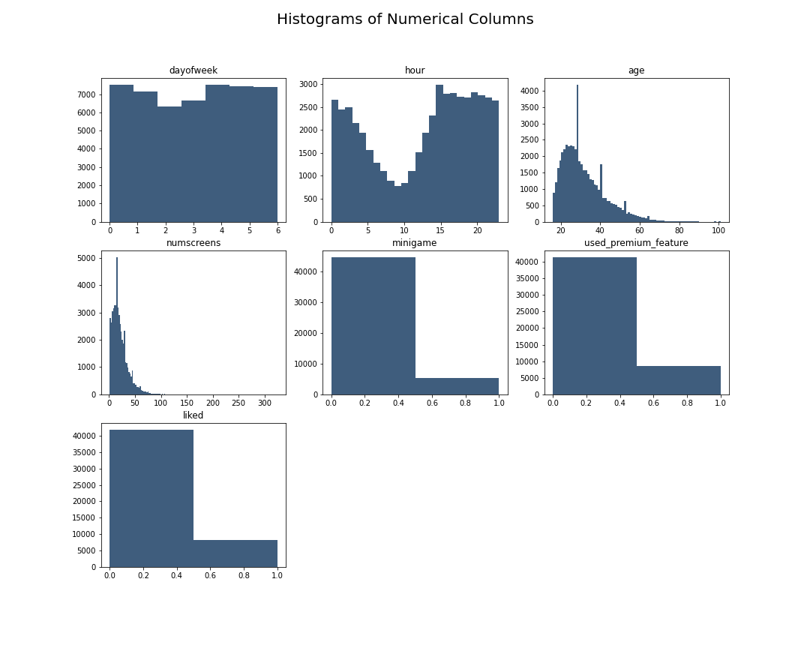
Histogram of Numerical Columns
DayOfWeek shows no pattern and all days seem to be similar for our app installation.
Hour shows a dip between 5am – 3pm
Age Group of 20-40 are the highest users.
NumScreens shows that most users see only 50 screens. However that maybe different screens.
Minigame, PremuimFeature and Liked does not show any significant pattern.
As seen, the histogram here is affected by outliers. That is not of any concern since we used Standardization.

Slide 10
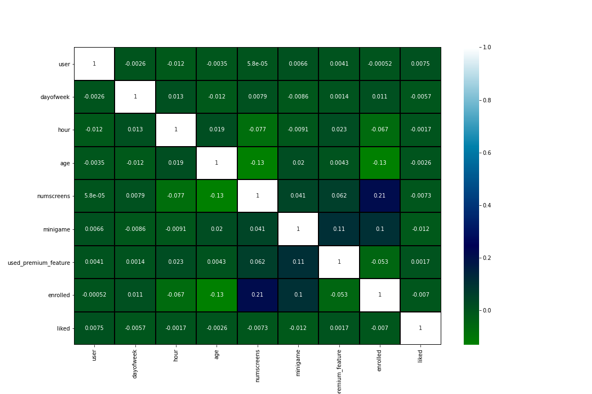
Heatmap
The following heatmap shows correlation of all our features with each other.
One example we can see is the correlation of ‘enrolled’ with ‘numscreens’. Both have a correlation of 0.21 with each other.
If two features/variables have a high correlation, it maybe of suspicion and should be removed as it can affect our model accuracy and give us false results.
One such case of high correlation was dealt in this project via funneling. Refer to my ‘Main Notebook’ if you want to read it.

Slide 11
Model Building
4

Slide 12




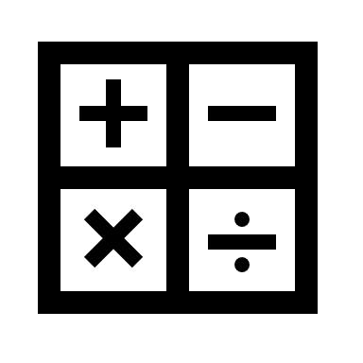
Notes on Model Building
Plotting with Matplotlib and Seaborn – A lot of time will be spent on Exploratory Data Analysis (EDA).
We will use Pandas and NumPy for all our Data Formatting & Manipulation steps.
The Model Building Process is composed of multiple parts.
Some of the things we will cover are mentioned here.
Previous knowledge of some of these concepts and tools have helped us understand the model building process quicker.
The libraries we have used are:
Pandas, NumPy, Seaborn, Matplotlib, Dateutil, Time, Random.
For Machine Learning we will use Logistic regression and Regularization Classification Models from the Sklearn Library.
For model validation and better accuracy we will use K-Fold Cross Validation, Grid Search for Parameter Tuning and Feature Selection(Engineering) algorithms.

Slide 13
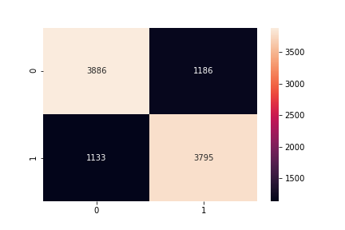
Confusion Matrix
The following is a confusion matrix representing our True/False Positive/Negative.
We have in total 1186 Type 1 Error and 1133 Type 2 Error
Accuracy Score and a Full Classification Report can be found in my ‘Main Notebook’. So make sure to check it out.

Slide 14
Conclusion
Our efforts have given us a model that will label every user as ‘highly likely’ or ‘unlikely’ to subscribe. We can further validate our results by running our predictions on daily new installs and see whether our accuracy is consistent. From there, we can narrow our marketing efforts only to those users ‘unlikely’ to subscribe, and thus increase our subscription rate.
The increase in overall subscriptions can measure the benefit of this model to the company. Recall that those already likely to subscribe will do so, and, although we can still give them offers, we don’t have to go all out. On the other hand users who are likely to leave may convert to paid subscribers if we give them an offer they cannot refuse. For example, these offers can come in the form of ‘1st month free’, or ‘50% off yearly subscription’. The latter shows that great offers can still be structured in a way that brings overall benefit to the company because we are locking the user in for an extended period!

Slide 15

Thank You!!

